Slide 1


International University
MICRO-PROCESSING SYSTEM
Lecture 5:
Jump and Call
Assembly Programming

Slide 2
Topics
Introduction to jump and call
Jump
Call
  Stack
  Calling a function
Time Delay

Slide 3
Jump and Call
CPU executes instructions one after another.
  For example in the following C program, CPU first executes the instruction of line 3 (adds b and c), then executes the instruction of line 4.
1
2
3
4
5
6
void main ()
{
a = b + c;
c -= 2;
d = a + c;
}

Slide 4
Jump and Call (Continued)
But sometimes we need the CPU to execute, an instruction other than the next instruction. For example:
  When we use a conditional instruction (if)
  When we make a loop
  When we call a function

Slide 5
Jump and Call (Continued)
Example 1: Not executing the next instruction, because of condition.
  In the following example, the instruction of line 6 is not executed.
1
2
3
4
5
6
7
8
9
void main ()
{
int a = 2;
int c = 3;
if (a == 8)
c = 6;
else
c = 7;
c = a + 3;
}

Slide 6
Jump and Call (Continued)
Example 2: In this example the next instruction will not be executed because of loop.
  In the following example, the order of execution is as follows:
    Line 4
    Line 5
    Again, line 4
    Again line 5
    Line 6
1
2
3
4
5
6
7
8
9
void main ()
{
int a, c = 0;
for(a = 2; a < 4; a++)
c += a;
a = c + 2;
}

Slide 7
Jump and Call (Continued)
Example 3: Not executing the next instruction, because of calling a function.
  In the following example, the instruction of line 6 is not executed after line 5.
Code
1
2
3
4
5
6
7
8
9
10
11
void func1 ();
void main ()
{
int a = 2, c = 3;
func1 ();
c = a + 3;
}
void func1 (){
int d = 5 / 2;
}

Slide 8
Jump and Call (Continued)
In the assembly language, there are 2 groups of instructions that make the CPU execute an instruction other than the next instruction. The instructions are:
  Jump: used for making loop and condition
  Call: used for making function calls

Slide 9
Jump
Jump changes the Program Counter (PC) and causes the CPU to execute an instruction other than the next instruction.

Slide 10
Jump
There are 2 kinds of Jump
  Unconditional Jump: When CPU executes an unconditional jump, it jumps unconditionally (without checking any condition) to the target location.
    Example: RJMP and JMP instructions
  Conditional Jump: When CPU executes a conditional jump, it checks a condition, if the condition is true then it jumps to the target location; otherwise, it executes the next instruction.

Slide 11
Unconditional Jump in AVR
There are 3 unconditional jump instructions in AVR: RJMP, JMP, and IJMP
We label the location where we want to jump, using a unique name, followed by ‘:’
Then, in front of the jump instruction we mention the name of the label.
This causes the CPU to jump to the location we have labeled, instead of executing the next instruction.
Code
1
2
3
4
5
LDI R16, 0
LDI R17, 2
L1: ADD R16, R17
RJMP L1
SUB R10,R15
L1:
L1

Slide 12
Ways of specifying the jump target
There are 3 ways to provide the jump address:
  PC = operand
  PC = PC + operand
  PC = Z register

Slide 13
JMP
JMP PC = operand
  Example:
    Operand = 0000000000000000000110
1001 010X XXXX 110X XXXX XXXX XXXX XXXX XXXX XXXX
1001 0100 0000 1100 0000 0000 0000 0110

Slide 14
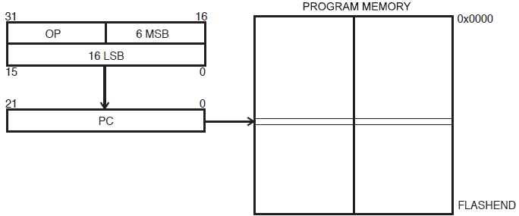


Direct Program Addressing, JMP and CALL
Syntax: Operands:
JMP k 0 ≤ k ≤ 4M
31
Machine code
0
Figure 11. Direct Program Memory Addressing
Program execution continues at the address immediate in the instruction word.

Slide 15
JMP
In JMP, the operand, contains the address of the destination
When an JMP is executed:
  PC is loaded with the operand value
PC:
Address
Code
0000
0001
0002
0007
0000
0000
0001
0002
0004
0005
0006
0006
0007
0009
.ORG 0
LDI R16, 15
LDI R17, 5
JMP LBL_NAME
LDI R18, 4
ADD R18, R17
LBL_NAME:
ADD R16,R17
JMP LBL_NAME
Machine code:
940C 0006
0006
opCode
operand
0006
Machine code:
940C 0006
0006
opCode
operand

Slide 16
RJMP (Relative jump)
RJMP PC = PC + operand
  Example:
    Operand = 000000000110
    PC = PC + 000000000110
1100 XXXX XXXX XXXX
1100 0000 0000 0110

Slide 17
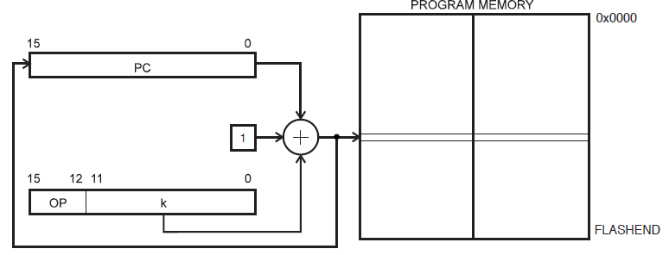
Relative Program Addressing, RJMP and RCALL
Figure 13. Relative Program Memory Addressing
Program execution continues at address PC + k + 1. The relative address k is from -2048 to 2047.
Ex: Syntax: Operands: Program Counter:
RJMP k -2048 ≤ k ≤ 2047 PC ← PC + k + 1
k (12-bit number) = Destination address – Next instruction address

Slide 18
RJMP
When RJMP is executed:
  The operand will be added to the current value of PC
PC:
0007
0003
0006
0002
0000
0001
Address
Code
+0
+F
0000
0000
0001
0002
0003
0004
0005
0005
0006
0007
.ORG 0
LDI R16, 15
LDI R17, 5
RJMP LBL_NAME
LDI R18, 4
ADD R18, R17
LBL_NAME:
ADD R16,R17
RJMP LBL_NAME
0005
0005
Machine code:
C002
002
opCode
operand
0005
Machine code:
CFFE
FFE
opCode
operand

Slide 19
IJMP (Indirect jump)
IJMP PC = Z register
The instruction has no operand.
the Program counter is loaded with the contents of Z register.
  For example, if Z points to location 100, by executing IJMP, the CPU jumps to location 100.
1001 0100 0000 1001

Slide 20
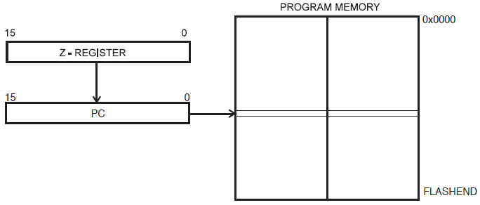
Indirect Program Addressing, IJMP and ICALL
Figure 12. Indirect Program Memory Addressing
Program execution continues at address contained by the Z register (i.e., the PC is loaded with the contents of the Z register).

Slide 21
Conditional Jump in AVR
SREG:
I
T
H
S
V
N
Z
C
The conditional jump instructions in AVR are as follows:
Instruction | Abbreviation of | Comment
BREQ lbl | Branch if Equal | Jump to location lbl if Z = 1,
BRNE lbl | Branch if Not Equal | Jump if Z = 0, to location lbl
BRCS lbl BRLO lbl | Branch if Carry Set Branch if Lower | Jump to location lbl, if C = 1
BRCC lbl BRSH lbl | Branch if Carry Cleared Branch if Same or Higher | Jump to location lbl, if C = 0
BRMI lbl | Branch if Minus | Jump to location lbl, if N = 1
BRPL lbl | Branch if Plus | Jump if N = 0
BRGE lbl | Branch if Greater or Equal | Jump if S = 0
BRLTlbl | Branch if Less Than | Jump if S = 1
BRHS lbl | Branch if Half Carry Set | If H = 1 then jump to lbl
BRHC lbl | Branch if Half Carry Cleared | if H = 0 then jump to lbl
BRTS | Branch if T flag Set | If T = 1 then jump to lbl
BRTC | Branch if T flag Cleared | If T = 0 then jump to lbl
BRIS | Branch if I flag set | If I = 1 then jump to lbl
BRIC | Branch if I flag cleared | If I = 0 then jump to lbl

Slide 22
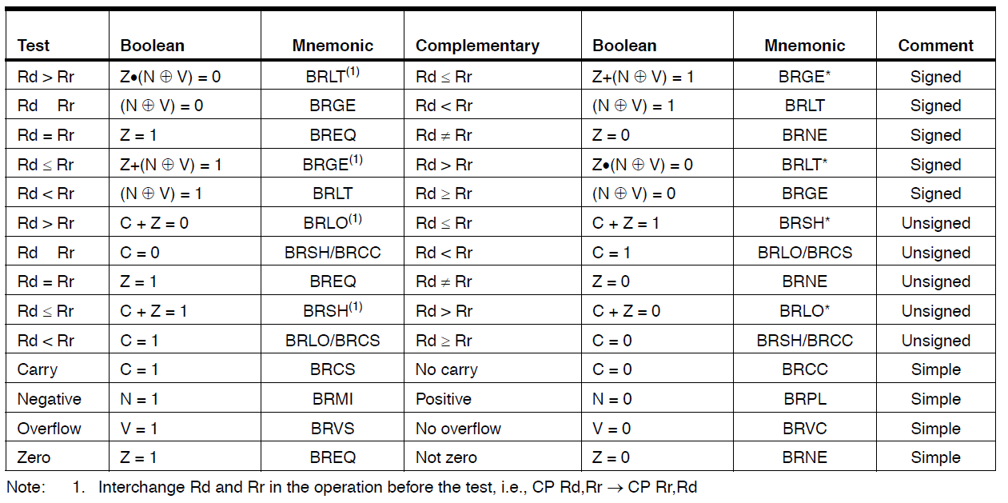
Conditional Branch Summary
≥
≥

Slide 23
Usages of Conditional jump
Conditions
Loop

Slide 24
Conditions
When b is subtracted from a:
  The result is zero, when a is equal to b
  Carry will be set when a < b
Compare:
  CP Rd,Rr ; 0 ≤ d, r ≤ 31 → Rd – Rr sets flags
  CPC Rd,Rr ; Rd – Rr – C sets flags
  CPI Rd,K ; 0 ≤ K ≤ 255 → Rd – K sets flags
a
- b

Slide 25
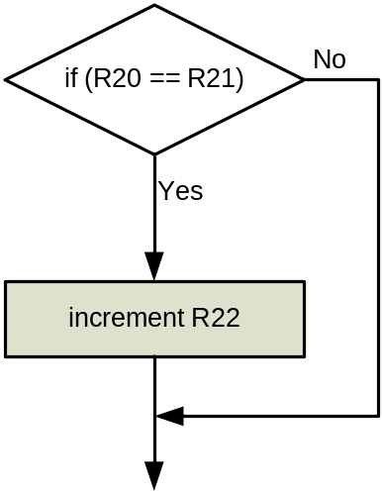
Example 1
Write a program that if R20 is equal to R21 then R22 increases.
Solution 1:
  SUB R20,R21 ;Z will be set if R20 == R21
  BRNE NEXT ;if Not Equal jump to next
  INC R22
  NEXT:
Solution2:
R20 is changed, R21 is unchanged
R20 and R21 are unchanged
  CP R20,R21 ;Z will be set if R20 == R21
  BRNE NEXT ;if Not Equal jump to next
  INC R22
NEXT:

Slide 26
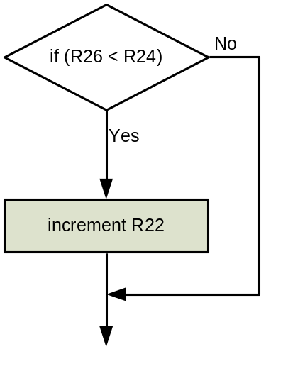
Example 2
Write a program that if R26 < R24 then R22 increases.
Solution:
  SUB R26,R24 ;Z will be set if R20 == R21
  BRCC L1 ;if Carry cleared jump to L1
  INC R22
  L1:

Slide 27
Example 3
Write a program that if R26 >= R24 then R22 increases.
Solution:
  SUB R26,R24 ;Z will be set if R20 == R21
  BRCS L1 ;if Carry set jump to L1
  INC R22
  L1:

Slide 28
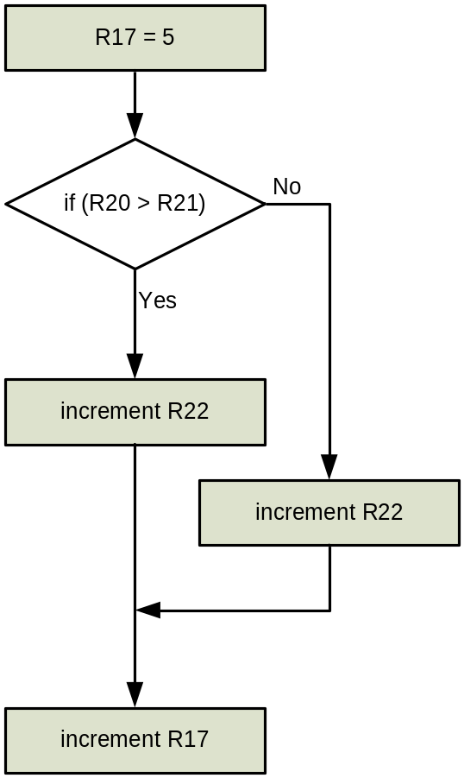
Example 4: IF and ELSE
R17 = 5;
if (R20 > R21)
R22++;
else
R22--;
R17 ++;
LDI R17,5
SUB R21,R20
BRCS IF_LABEL
DEC R22
JMP NEXT
IF_LABEL:
INC R22
NEXT:
INC R17

Slide 29
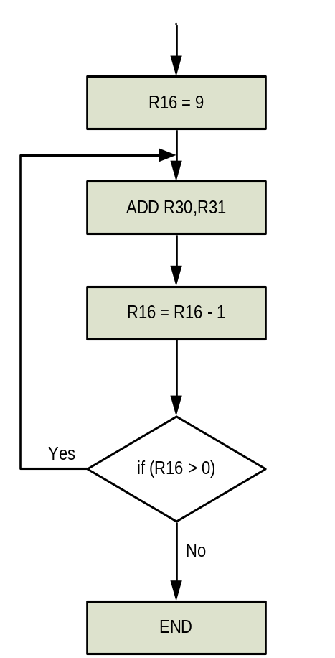
Loop
Write a program that executes the instruction “ADD R30,R31” 9 times.
Solution:
.ORG 00
LDI R16,9 ;R16 = 9
L1: ADD R30,R31
DEC R16 ;R16 = R16 - 1
BRNE L1 ;if Z = 0
L2: RJMP L2 ;Wait here forever

Slide 30
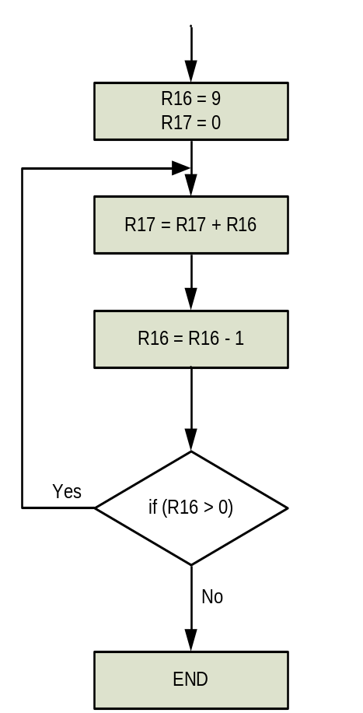
Loop
Write a program that calculates the result of 9+8+7+…+1
Solution:
.ORG 00
LDI R16, 9 ;R16 = 9
LDI R17, 0 ;R17 = 0
L1: ADD R17,R16 ;R17 = R17 + R16
DEC R16 ;R16 = R16 - 1
BRNE L1 ;if Z = 0
L2: RJMP L2 ;Wait here forever

Slide 31
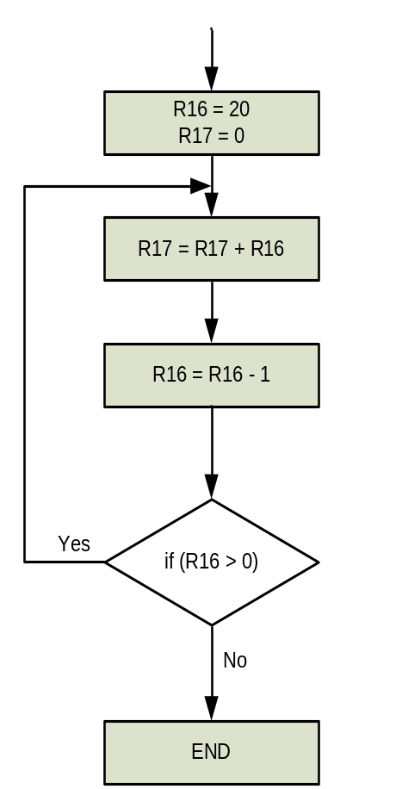
Loop
Write a program that calculates the result of 20+19+18+17+…+1
Solution:
.ORG 00
LDI R16, 20 ;R16 = 20
LDI R17, 0 ;R17 = 0
L1: ADD R17,R16 ;R17 = R17 + R16
DEC R16 ;R16 = R16 - 1
BRNE L1 ;if Z = 0
L2: RJMP L2 ;Wait here forever

Slide 32
Loop
for (init; condition; calculation)
{
do something
}
init
Do something
calculation
Yes
Condition
No
END

Slide 33
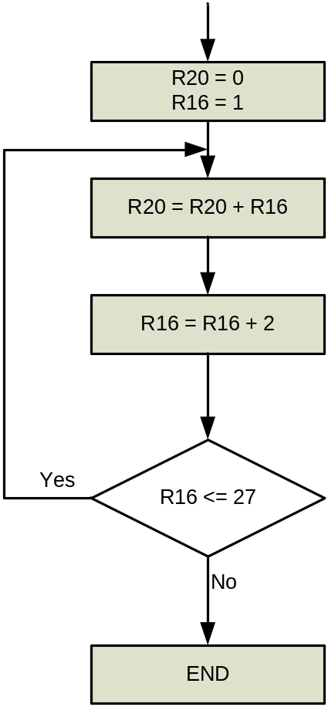
Loop
Write a program that calculates 1+3+5+…+27
Solution:
LDI R20,0
LDI R16,1
L1:ADD R20,R16
LDI R17,2
ADD R16,R17 ;R16 = R16 + 2
LDI R17,27 ;R17 = 27
SUB R17,R16
BRCC L1 ;if R16 <= 27 jump L1

Slide 34
Call Topics
Stack, Push and Pop
Calling a function

Slide 35
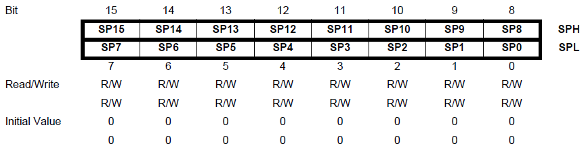
Stack Pointer or SP
On RISC machines, the stack is much less used than some other architectures. This is because there are many registers where one can store temporary data.
AVRs have a stack, and it is mainly used for storing temporary data, for storing local variables and for storing return addresses after interrupts and subroutine calls.
The AVR Stack Pointer or SP is consists of two 8-bit registers in the I/O space, namely SPH and SPL.
The stack is implemented in SRAM, and SP always points to the top of the stack and decrements with a push instruction.
IOR Addr | SRAM Addr
$3E | $5E
$3D | $5D

Slide 36
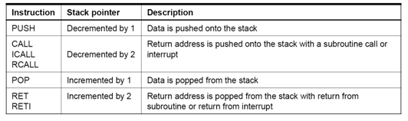
SP
AVR processors automatically push the return address during a subroutine call (CALL, RCALL, …)
AVR processors automatically pop the return address as part of the return (RET) instruction
AVR processors automatically push the return address when an interrupt occurs
Interrupt service routines (ISPs) should return with an RETI instruction, which pops the return address
AVR Instructions that affect SP

Slide 37
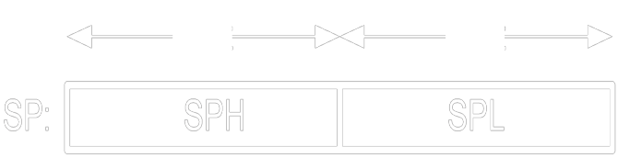
Stack
PUSH Rr
  [SP] = Rr
  SP = SP - 1
POP Rd
SP = SP + 1
Rd = [SP]
SP
Stack

Slide 38
Stack
The stack is implemented in SRAM, and SP always points to the top of the stack and decrements with a PUSH instruction.
Thus, to utilize the stack using the PUSH and POP instructions, one must initialize SP properly.
On AVRs, SP is initialized to the end of SRAM
Other AVR documentation suggest that at reset, SP is initialized to 0x00, which is where the 32 general purpose registers start—see the AVR memory map, so programmer has to initialize SP
; Point the stack to end of SRAM.
ldi r23,LOW(RAMEND) ; Load LSB of last SRAM address in r23
out spl,r23
ldi r23,HIGH(RAMEND) ; Load MSB of last SRAM address in r23
out sph,r23

Slide 39
Stack
SP is located in I/O space so we use IN and OUT instructions
RAMEND is defined in “m32def.inc”
; Point the stack to end of SRAM.
ldi r23, LOW(RAMEND) ; Load LSB of last SRAM address in r23
out spl,r23
ldi r23,HIGH(RAMEND ) ; Load MSB of last SRAM address in r23
out sph,r23
.include “m32def.inc”
LOW
RAMEND
out
HIGH
RAMEND
LOW and HIGH are Assembler operators that extract LSB and MSB from RAMEND.

Slide 40
Stack
Address
Code
ORG 0
LDI R16,HIGH(RAMEND)
OUT SPH,R16
LDI R16,LOW(RAMEND)
OUT SPL,R16
LDI R20,0x10
LDI R21, 0x20
LDI R22,0x30
PUSH R20
PUSH R21
PUSH R22
POP R21
POP R0
POP R20
L1: RJMP L1
0000
0001
0002
0003
0004
0005
0006
0007
0008
0009
000A
000B
000C
000D
$10
$00
$30
R20:
R22:
$00
R21:
$00
$20
R0:
$00
SP
0000
$10
$20
$30
Memory

Slide 41
Calling a Function
To execute a call:
  Address of the next instruction is saved
  PC is loaded with the appropriate value
Address
Code
0000
0001
0002
0003
0004
0005
0006
0008
0009
000A
000A
000B
000C
000D
LDI R16,HIGH(RAMEND)
OUT SPH,R16
LDI R16,LOW(RAMEND)
OUT SPL,R16
LDI R20,15
LDI R21,5
CALL FUNC_NAME
INC R20
L1: RJMP L1
FUNC_NAME:
ADD R20,R21
SUBI R20,3
RET
Machine code:
940E 000A
0006
000A
opCode
operand
00
08
SP
PC:
0004
0005
0006
000B
000C
0008
0009
Stack

Slide 42
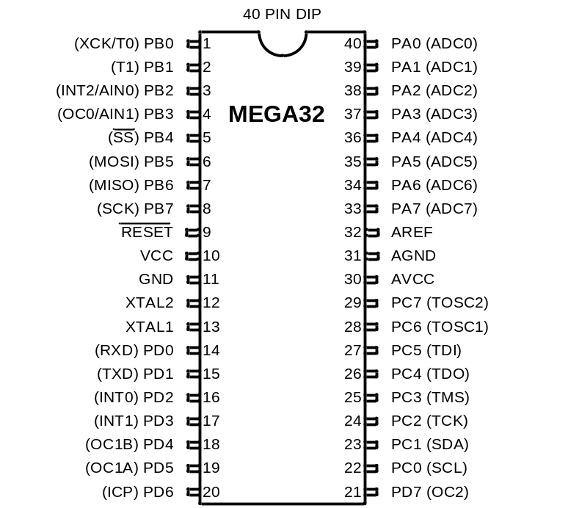
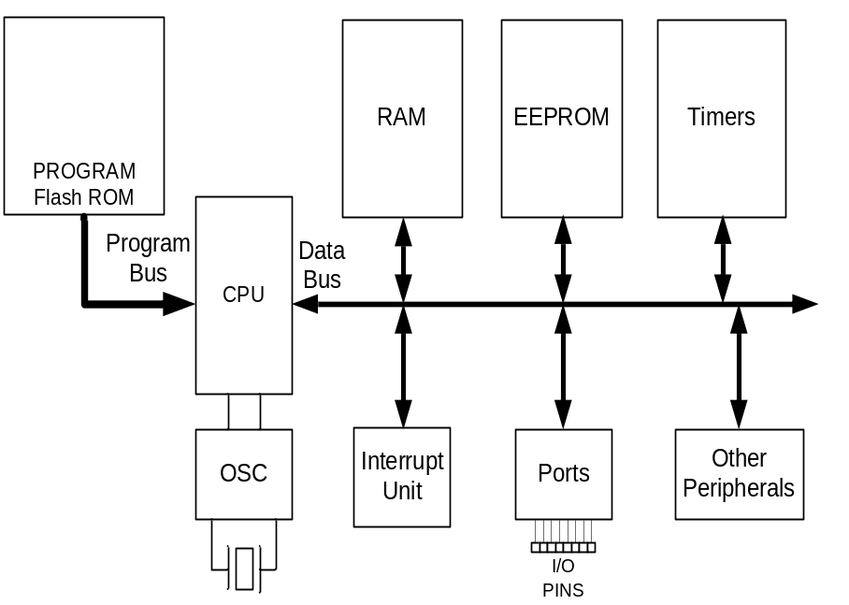

Time delay

Slide 43
Time delay
machine cycle
1
1
1
1
1
5
LDI R16, 19
LDI R20, 95
LDI R21, 5
ADD R16, R20
ADD R16, R21

Slide 44
Time delay
machine cycle
1
1
1
1/2
LDI R16, 100
AGAIN: ADD R17,R16
DEC R16
BRNE AGAIN
*100
*100
*100
Branch penalty
Total = 1 + (1+1+2) x 100 -1 = 400 cycles
If XTAL = 10 MHz then execution time for this code is 400 x 1/(10MHz) = 40 µs
Syntax: Operands: Program Counter: Cycles:
BRNE k -64 ≤ k ≤ +63 PC ← PC + k + 1 2
PC ← PC + 1, if condition is false 1

Slide 45
Time delay
machine cycle
1
1
1
1
1/2
LDI R16, 50
AGAIN: NOP
NOP
DEC R16
BRNE AGAIN
*50
*50
*50
*50

Slide 46
Time delay
machine cycle
1
1
1
1
1
1/2
1
1/2
LDI R17, 20
L1: LDI R16, 50
L2: NOP
NOP
DEC R16
BRNE L2
DEC R17
BRNE L1
*20
*20 * 50
*20 * 50
*20 * 50
*20 * 50
*20
*20

